Slide 1
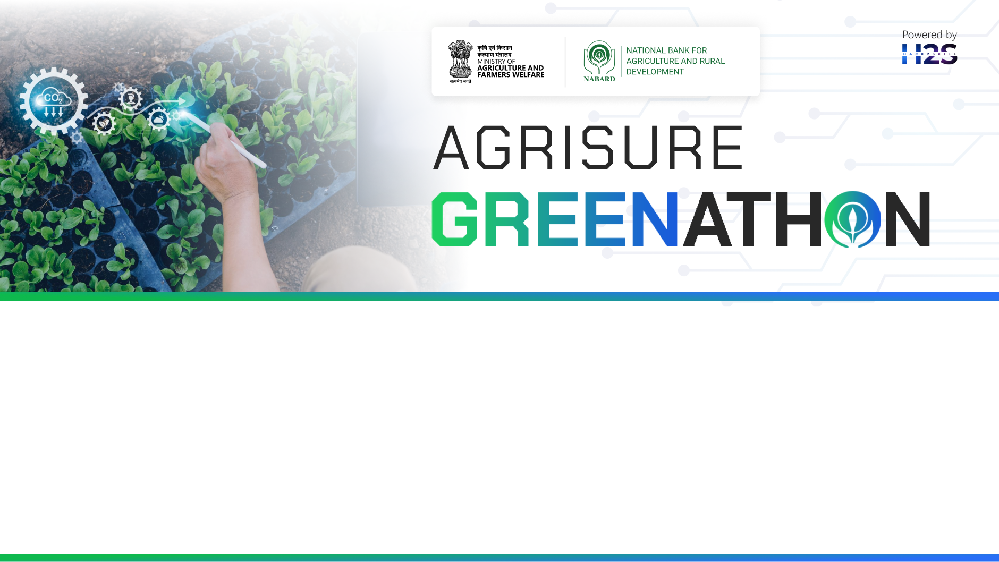
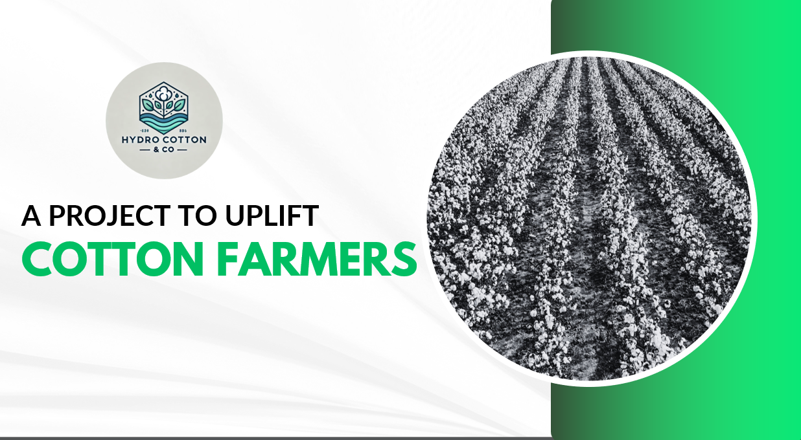
Team: HydroBloom Agri Tech
Team Leader Name: Jahnav Shanker Reddy
Problem Statement:

Slide 2

Problem Statement
Section | Details
Problem | Dependency on Imported ELS Cotton: Affects economic self-reliance Economic Challenges: High electricity costs and initial capital investment in hydroponics Resource Inefficiency: Excessive water and fertilizer use in traditional farming.
Solution | Dual-Crop System - Pima Cotton (June – December)- Cucumbers (January - June) - Ensures year-round productivity and offsets electricity costs.- Increase domestic ELS cotton production to reduce import dependency.
Alignment with UN SDGs | Goal 2: Zero Hunger: Improved agricultural productivity.- Goal 6: Clean Water and Sanitation: Hydroponics reduces water usage by 90%.- Goal 7: Affordable and Clean Energy: Energy-efficient hydroponic systems.- Goal 8: Decent Work and Economic Growth: Stable income for farmers.- Goal 12: Responsible Consumption and Production: Efficient resource use.
Call to Action | - Secure funding from NABARD to overcome financial hurdles and demonstrate a sustainable model for hydroponic farming.

Slide 3
India, Despite being amongst the largest producers of Cotton, has to import High-Quality cotton from USA, Australia, Peru and other countries. The country has immense potential to be exporter of High Quality cotton. Farmer’s of our country are losing substantial opportunities as they are unable to grow Internationally recognized Cotton varieties.
However, going International variety of cotton is difficult in the climatic conditions of India.
By Growing Cotton in a controlled environment (Hydroponically), we will be able to manufacture cotton of the highest quality to meet both domestic and International demand.

Slide 4
How different is it from any of the other existing ideas?
The Hydroponic idea uses the functionality of controlled environment to mitigate climate impact, uses precision agriculture technique and Aides in the reduction of water by up to 95%.
How will it be able to solve the problem?
The hydroponic system is compliant with UN Sustainable Development goals 2030. It reduced Carbon footprint and promotes sustainable agriculture practices.
USP of the proposed solution
Growing of the highest quality cotton produce in India (Which can be exported outside India)

Slide 5
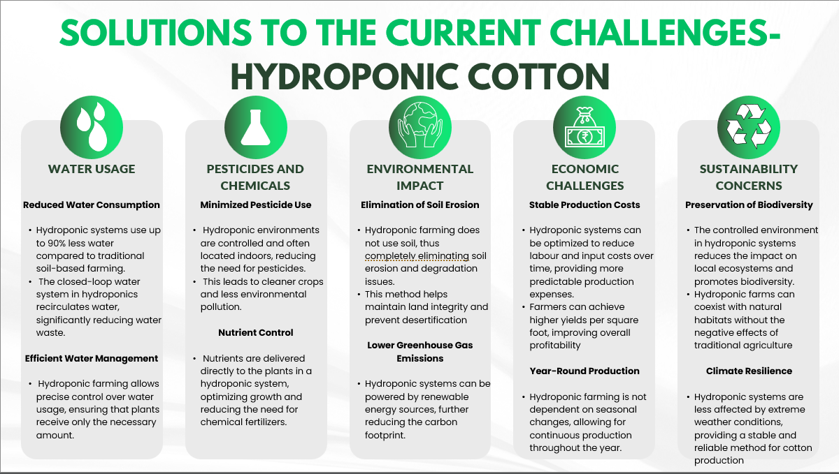

Slide 6
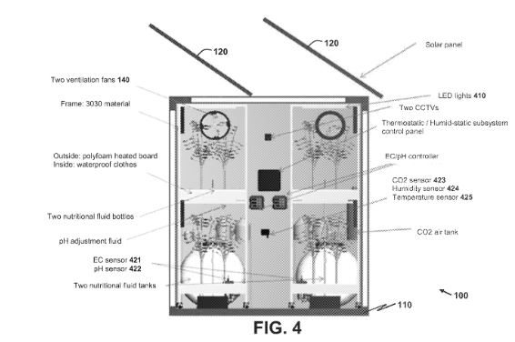
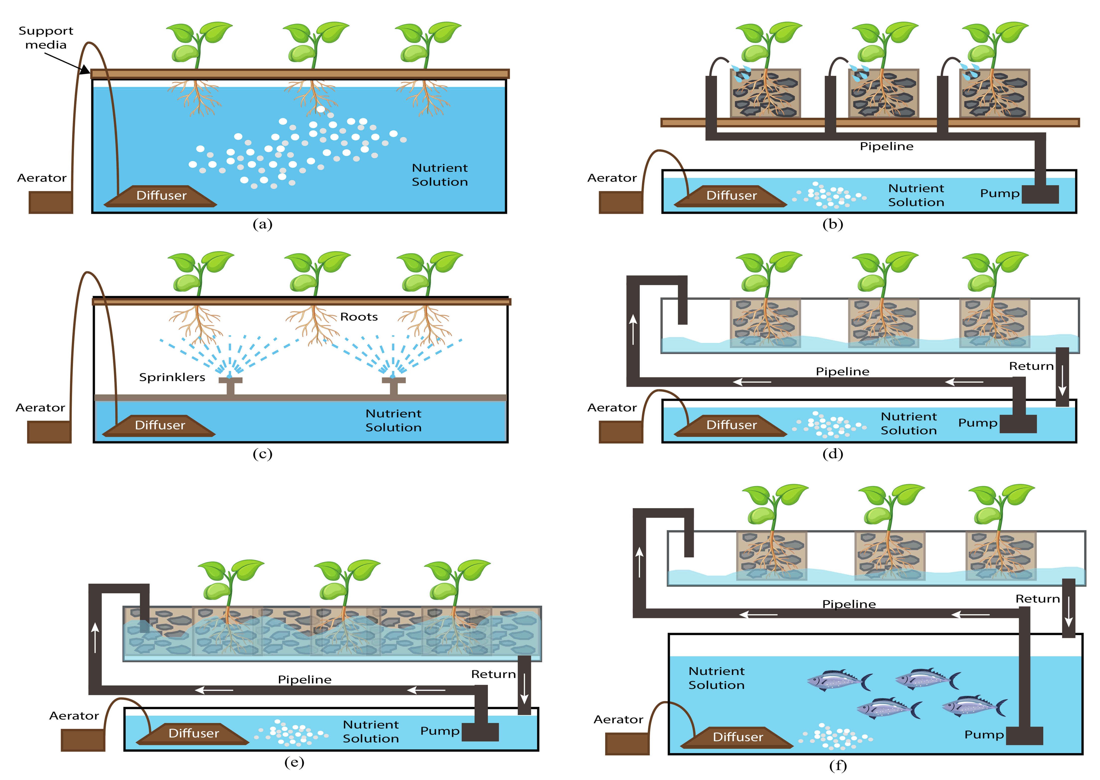
Process flow diagram & Architecture
OPTION I – Traditional Hydroponic System
OPTION II – CAPEX heavy hydroponics

Slide 7
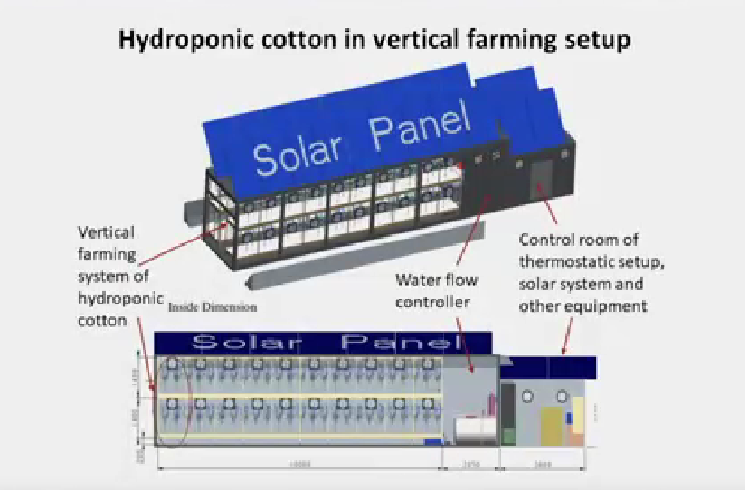
Technologies to be used in the solution
Hydroponics with grow slabs
Artificial ventilation systems
Grow light mechanisms
Automated Nutrition feeder
RO systems
Foggers
Drippers
Humidifiers

Slide 8
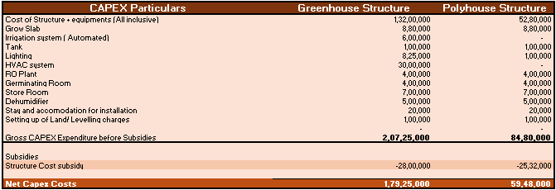
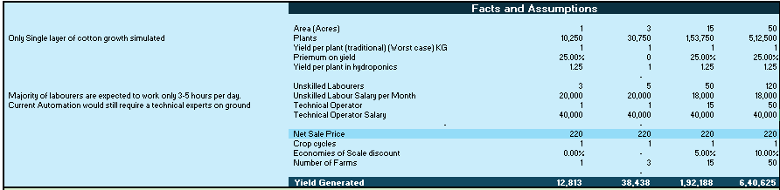
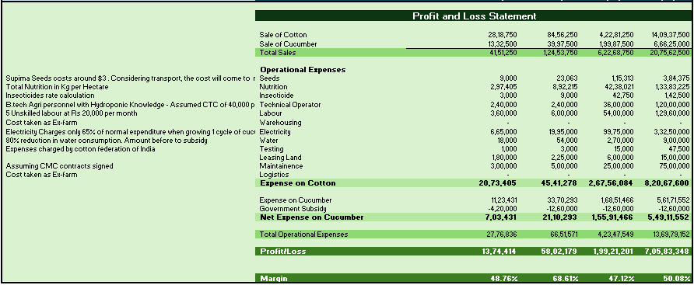
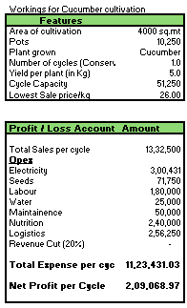
FINANCIAL ANALYSIS OF INDIVIDUAL FARM

Slide 9

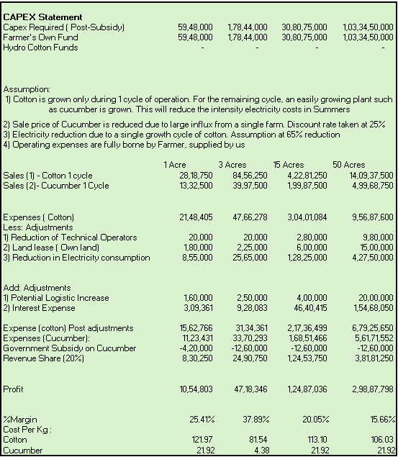
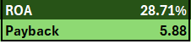

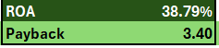
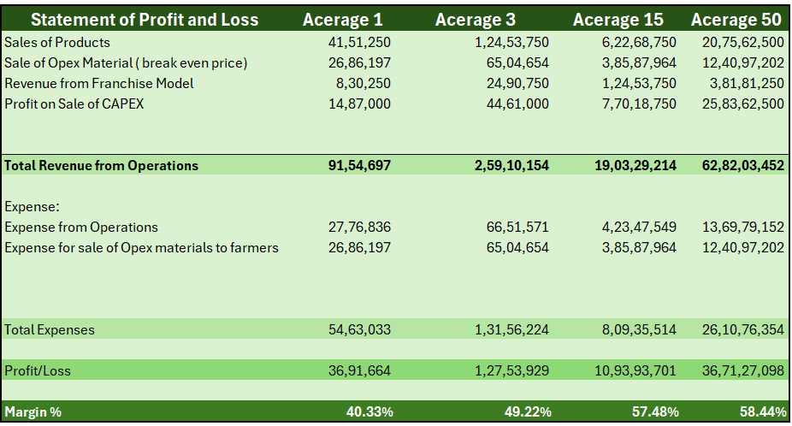
FINANCIAL ANALYSIS
Farmers Financials

Slide 10

Additional Details/Future Developments
Our R&D process is to grow a sample size of cotton plant to identify the one with the greatest yield
Upon success of the product, the technology gets released to Indian farmers with 1 Acre of land
We also open up potential for export of these materials to South East Asia
Currently, we are in talks with a university in Mexico. They are interested in R&D in Mexico, but we want to do R&D in INDIA.

Slide 11
